Slide 1
4483/8995 CAPSTONE PROJECT PRESENTATION
Nba_forecast
Somya Shukla, u3238876
Pranva’s group, Friday 12-May-2023, 14:00

Slide 2
Table of Contents
Introduction / Problem Statement
Dataset Details
EDA (Exploratory Data Analysis) Outcomes
PDA (Predictive Data Analytics) Outcomes
Implementation and Deployment (TkInter/Flask/Streamlit) Plan and Status Update
References/Bibliography

Slide 3
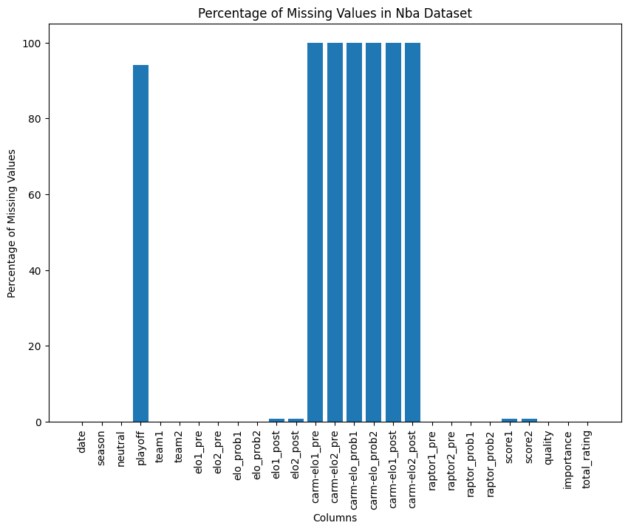
Introduction / Problem Statement
The dataset referred to as nba_forecast [1] is quite large, with over 1300 rows. However, it contains numerous null values which may impact its usefulness for analysis. Additionally, the dataset does not provide clear information about which team won each game, making it difficult to perform certain types of analysis. Furthermore, the description of the dataset is not very clear or informative, which could hinder efforts to work with the data effectively. As a result, some preprocessing and data cleaning may be necessary before conducting any meaningful analysis.

Slide 4
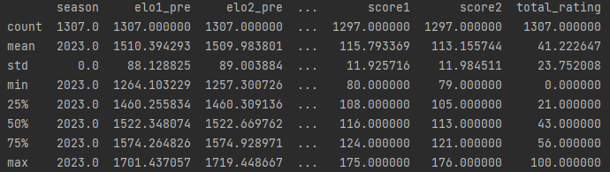
2. Dataset Details
The dataset contains information on NBA games from the 2023 season. Each row represents a game between two teams, with information such as the teams involved, their pre-game Elo ratings, the Elo probabilities of each team winning, and their post-game Elo ratings.
Summary Statistics

Slide 5
3. EDA (Exploratory Data Analysis) Outcomes
Winning frequency for each team: This can be visualized using a bar chart or a table showing the total number of wins and losses for each team in the dataset.
Distribution of elo_prob1 for all games in the dataset: This can be visualized using a histogram or a density plot to show the frequency of elo_prob1 values in the dataset.
Distribution of elo_prob2 for all games in the dataset: This can also be visualized using a histogram or a density plot to show the frequency of elo_prob2 values in the dataset.
Correlation between the difference in elo1_pre ratings and final score difference: This can be analyzed using a scatter plot, where the x-axis shows the difference in elo1_pre ratings between the two teams and the y-axis shows the final score difference.Team with the highest average elo1_pre rating: This can be calculated by averaging the elo1_pre ratings for all games for each team and then selecting the team with the highest average. This information can be presented in a table or a bar chart.

Slide 6
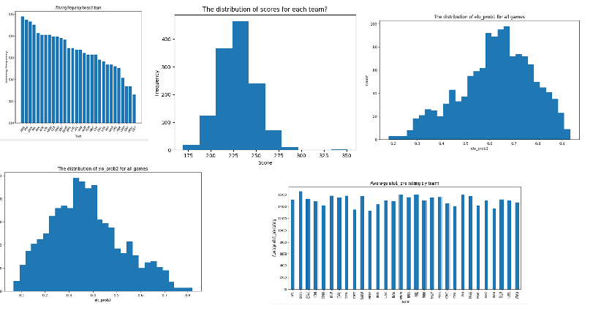
3. EDA (Exploratory Data Analysis) Outcomes

Slide 7
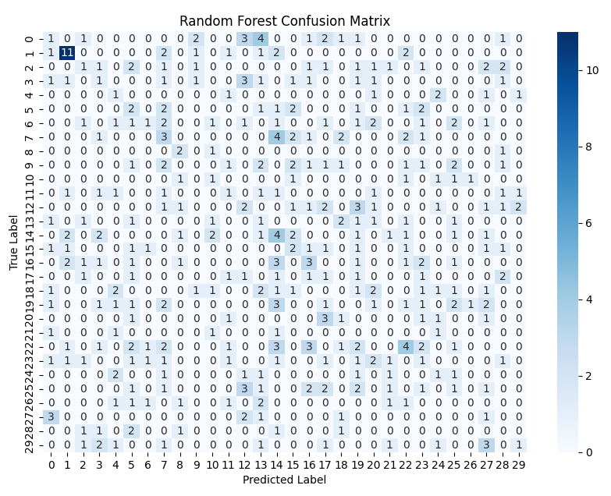
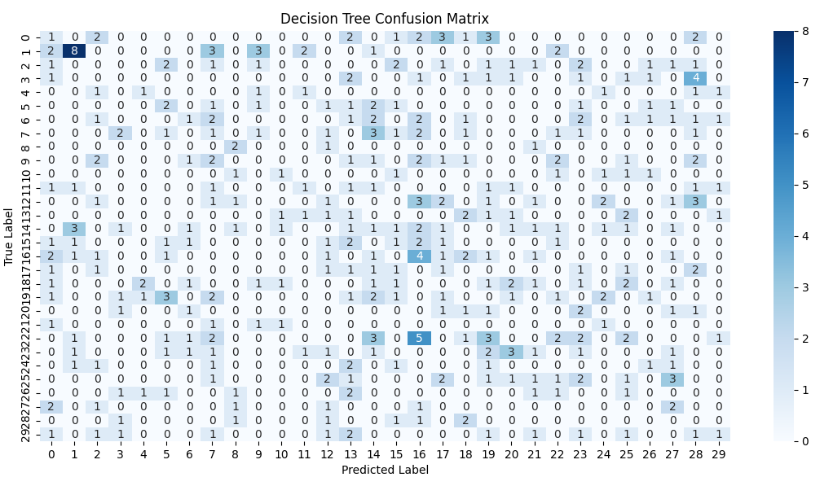
4. PDA (Predictive Data Analysis) Outcomes
According to the findings, it appears that the Random Forest algorithm has the highest accuracy of 0.1068. Following that, the SVM algorithm has an accuracy of 0.0916, and the Decision Tree algorithm has an accuracy of 0.0789.
The Random Forest model's accuracy did not greatly increase. Although significantly less than the initial accuracy of 0.1069, the greatest accuracy obtained with the modified settings is still 0.1043. It's likely that Random Forest is not the best model for this task, or that the hyperparameters we selected were not the best ones for this particular dataset.
The SVM model, on the other hand, had the highest accuracy, 0.0916, which is still not a very high accuracy but superior to the other two models. By experimenting with additional hyperparameters or feature engineering methods, we might try to further enhance the SVM model.

Slide 8
5. Implementation and Deployment (TkInter/Flask/Streamlit) Plan and Status Update
Data Preparation: This stage involved the collection and cleaning of the data. The data was obtained from FiveThirtyEight, and then cleaned to remove any missing or duplicate values.
Algorithm Implementation: This stage involved the implementation and evaluation of three different algorithms: SVM, Decision Tree, and Random Forest.
The algorithms were evaluated using grid-search and the best algorithm was selected based on its accuracy score.
Software Deployment: The software was deployed using Streamlit, which allowed users to interact with the software through a user-friendly web interface.

Slide 9
References /Bibilography
[1] https://projects.fivethirtyeight.com/2023-nba-predictions/

